Slide 1
BCSE352E – Essentials of Data Analytics Digital Assignment 2
FINDING BEST LAPTOPS FOR FRESHERS
SUBMITTED BY :
Niranjana shaji:21BLC1264
SUBMITTED TO: Dr. JEETASHREE APARAJEETHA

Slide 2
Pre-processing Techniques
Codes
data1=read.csv("C:/Users/91903/Downloads/archive (2) (3)/Laptops.csv")
View(data1)
str(data1)
data2=read.csv("C:/Users/91903/Downloads/archive (1) (2)/Laptop_price.csv")
View(data2)
str(data2)
// loading 2 datasets into the rstudio and find the datatype of each features

Slide 3
Clearing anomalies present in both dataset1 and 2
# Remove NA values from particular column
codes
data1 <- data1[!is.na(data1$Storage), ]
print(data1)
View(data1)
# Print the updated structure of the dataset
str(data1)
data2 <- data2[!is.na(data1$Storage), ]
print(data2)
View(data2)
# Print the updated structure of the dataset
str(data2)

Slide 4
Merging datasets 1 and 2 after cleaning
codes
merged_df <- merge(data1, data2, by = “s.no")
//we are merging 2 datasets with the name of a common key column that is serial no after cleaning both datasets
df_modified <- data2[, -c(2, 6)]print(df_modified)
View(df_modified)
summary(data1)
head(data1)
//Omitted 2 unnecessary column from merged dataset

Slide 5
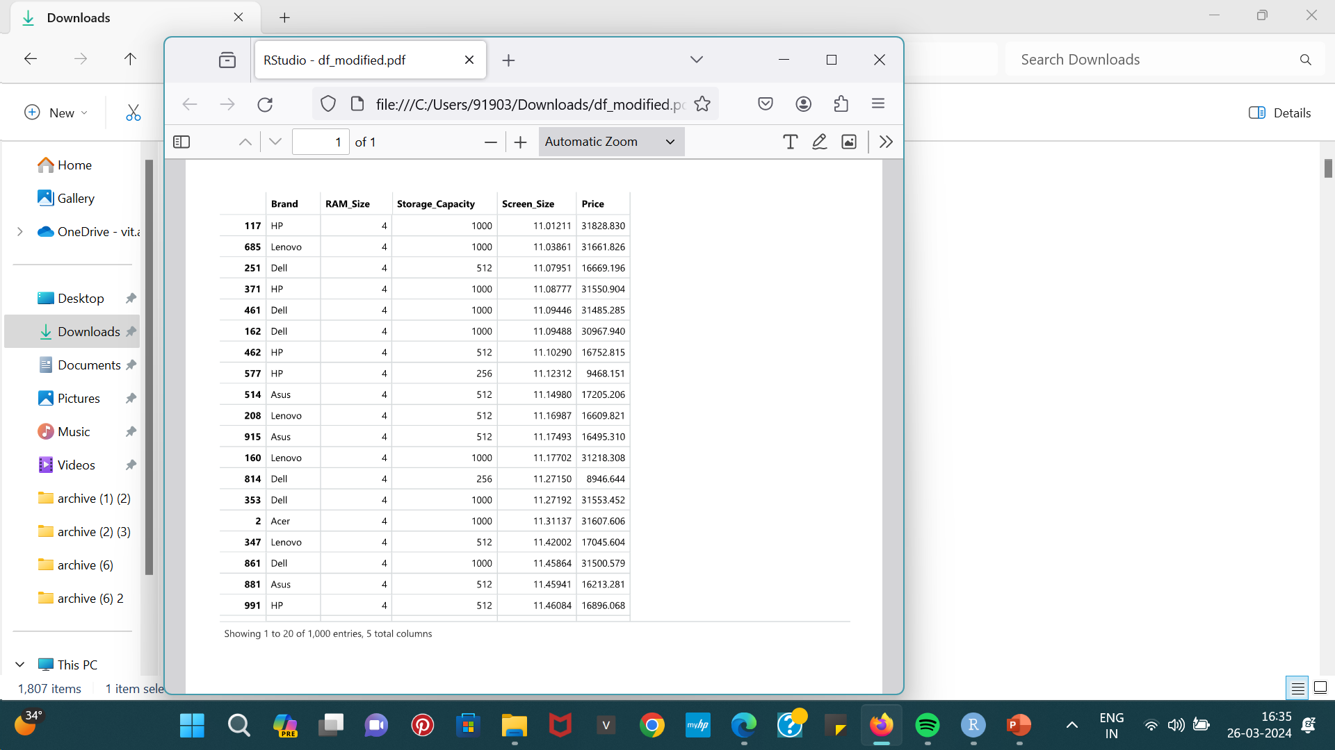
This is small part of the merged dataset in Rstudio

Slide 6
FINDING THE CORRELATION BTW DIFFERENT FEATURES
correlation_matrix< cor(df_modified$Storage_Capacity,df_modified$RAM_Size)
correlation_matrix <- cor(df_modified$Screen_Size,df_modified$RAM_Size)
correlation_matrix <- cor(df_modified$Screen_Size,df_modified$Storage_Capacity)
correlation_matrix <- cor(df_modified$Screen_Size,df_modified$Price)
correlation_matrix <- cor(df_modified$Storage_Capacity,df_modified$Price)
correlation_matrix cor(df_modified$RAM_Size,df_modified$Price)
print(correlation_matrix)
This shows there is strong positive linear relationship btw price and storage capacity,the price increases with increasing storage capacity.
The correlation btw price and storage_capacity was 0.99 which is closer to 1.
Among the laptops “Asus” is showing this variation as its Storage_capacity is more which resulted in its higher price ,which is one reason for “Asus” to be best laptop”

Slide 7
Performing regression
model <- lm(df_modified$Storage_Capacity ~ df_modified$RAM_Size, df_modified=df_modified
# Print the summary of the model#
summary(model)
# Fit a linear regression model#
model <- lm(Storage ~ RAM, data=data)#
Create a scatter plot of RAM vs Storage
plot(df_modified$RAM_Size, df_modified$Storage_Capacity, main="Scatter Plot with Regression Line", xlab="RAM_Size", ylab="Storage_Capacity", pch=16, col="blue“)
plot(df_modified$Price, df_modified$Storage_Capacity, main="Scatter Plot with Regression Line", xlab="Storage_Capacity", ylab="Price", pch=16, col="blue")
# Add regression line
abline(model, col="red")

Slide 8
Its produced a positive linear relationship
as the storage capacity increases, the price tends to increase (or decrease if the slope is negative), and this relationship can be described by a straight line.
.This also shows “Asus” is the better option.

Slide 9
Correlation Heatmap
Code:
library(ggplot2)#
Create a ggplot object
ggplot(df_modified, aes(x = Storage_Capacity, y = Price, fill = correlation_matrix)) + geom_tile() + scale_fill_gradient(low = "blue", high = "red") + labs(title = "Correlation Heatmap between Storage Capacity and Price", x = "Storage Capacity (GB)", y = "Price ($)")

Slide 10
PREPROCESSING
MERGING 2 DATASETS
CORRELATION MATRIX
BLOCK DIAGRAM
LINEAR REGRESSION
CORRELATION HEATMAP
HIERARCHICAL CLUSTERING
DENDOGRAM

Slide 11
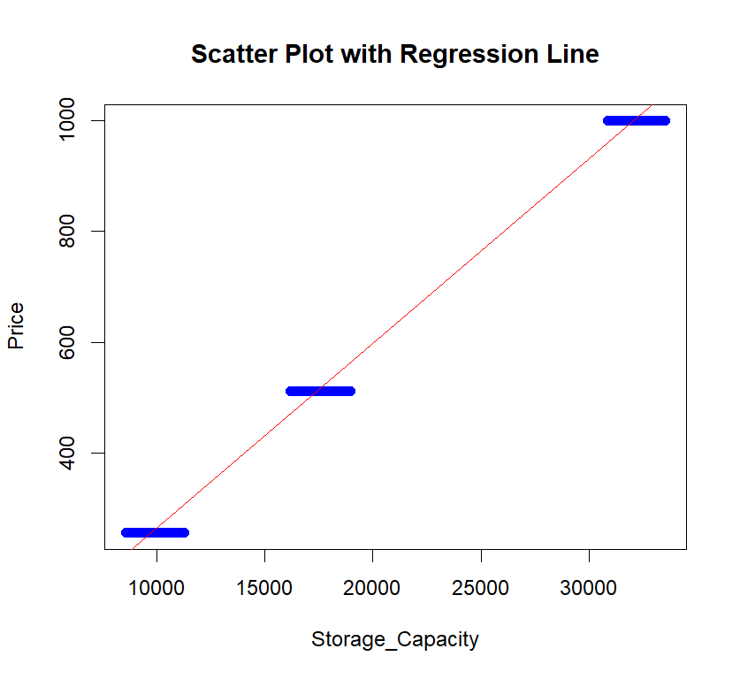
CHANGE IN DATA POST PRE-PROCESSING
VISUALISATION TECHNIQUES
SCATTER PLOT WITH REGRESSION LINE
(showed a strong positive relationship btw price and storage )

Slide 12
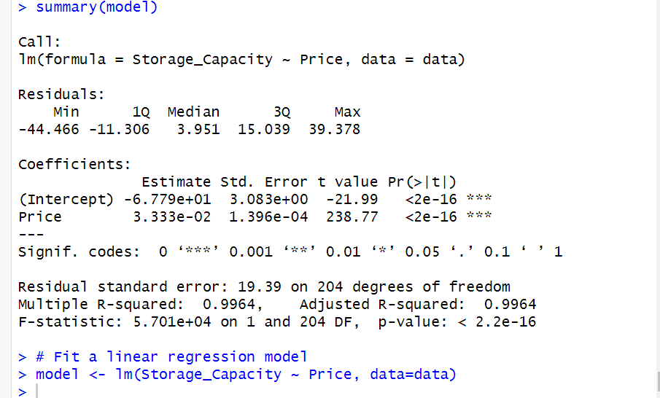
SUMMARY OF THE LINEAR REGRESSION MODEL

Slide 13
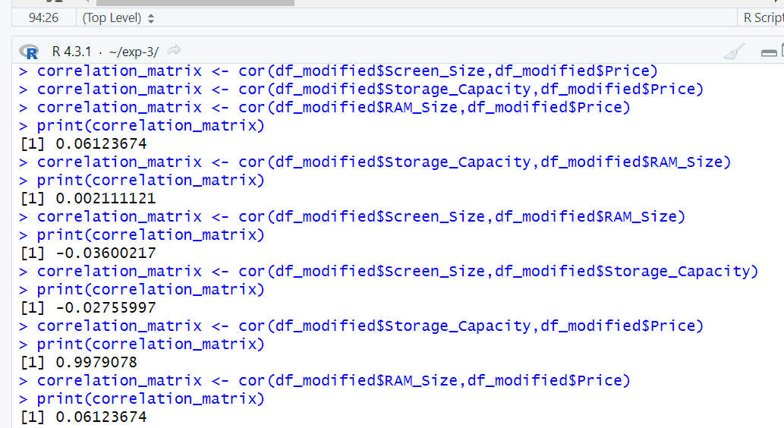
CORRELATION MATRIX

Slide 14
We found the correlation matrix btw each features and found out price and storage_capacity has a positive linear relationship of 0.99 which is closer to 1 which means price increase with the increasing storage_capacity,Thus this variation was seen in “Asus” laptop brand which resulted it to be one reason for best laptop for students.

Slide 15
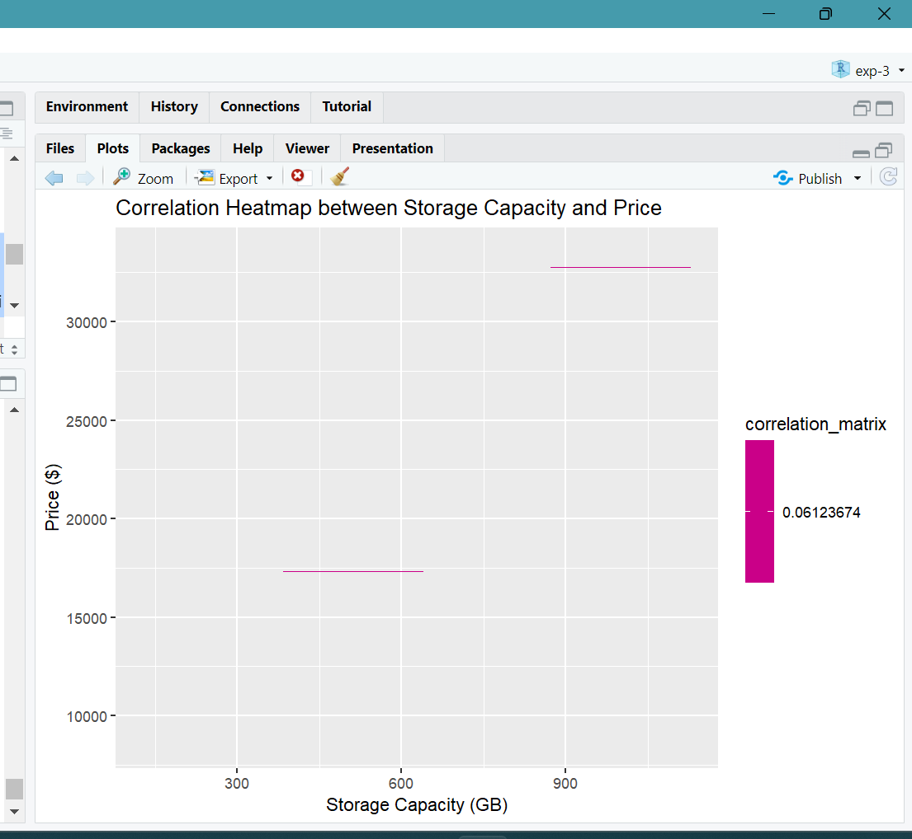
HEATMAP

Slide 16
Correlation Heatmap: Used to visualize correlations between variables. Positive correlations are often represented by one color (e.g., shades of green), while negative correlations are represented by another color (e.g., shades of red).
Correlation Heatmap was plotted btw 2 variables storage_capacity and price,which also resulted from the observation that “asus” is the best one.

Slide 17
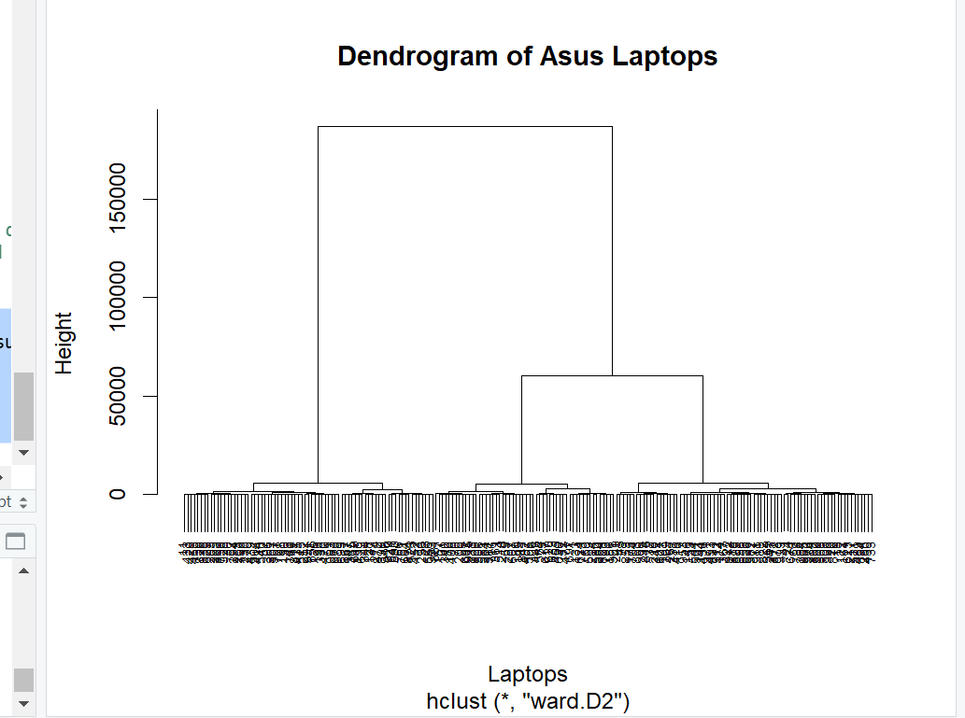
DENDOGRAM

Slide 18
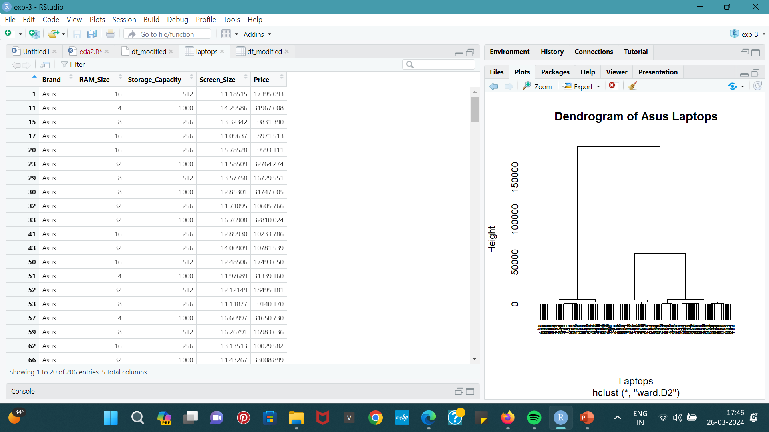
Final dataset obtained after Hierarchial clustering

Slide 19
Model used
-The model used here is “Hierarchical clustering “.
Code:
#hierarchial clustering
data <- subset(df_modified, df_modified$Brand == "Asus")
# Select features for clustering (price and storage capacity)
features <- data[, c('Price', 'Storage_Capacity','RAM_Size’)]
# Perform hierarchical clustering
d <- dist(features, method = "euclidean")
# Calculate Euclidean distance between data pointshc
<- hclust(d, method = "ward.D2")
# Perform hierarchical clustering using Ward's method
# Plot dendrogram
library(stats)
plot(hc, main = "Dendrogram of Asus Laptops", xlab = "Laptops", sub = NULL, cex = 0.6)

Slide 20
EXPLANATION:
Hierarchical clustering is a method of cluster analysis that builds a hierarchy of clusters. It's a bottom-up approach where each data point starts as its cluster, and pairs of clusters are merged iteratively based on a similarity measure until all data points belong to a single cluster.
Here we found “ASUS”: TO BE THE BEST LAPTOP based on its features like price, storage and screen size, the dendogram obtained resulted in this solution.

Slide 21
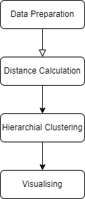
BLOCK DIAGRAM

Slide 22
Another approach using python with different sets of dataset
Preprocessing part
Code:

Slide 23
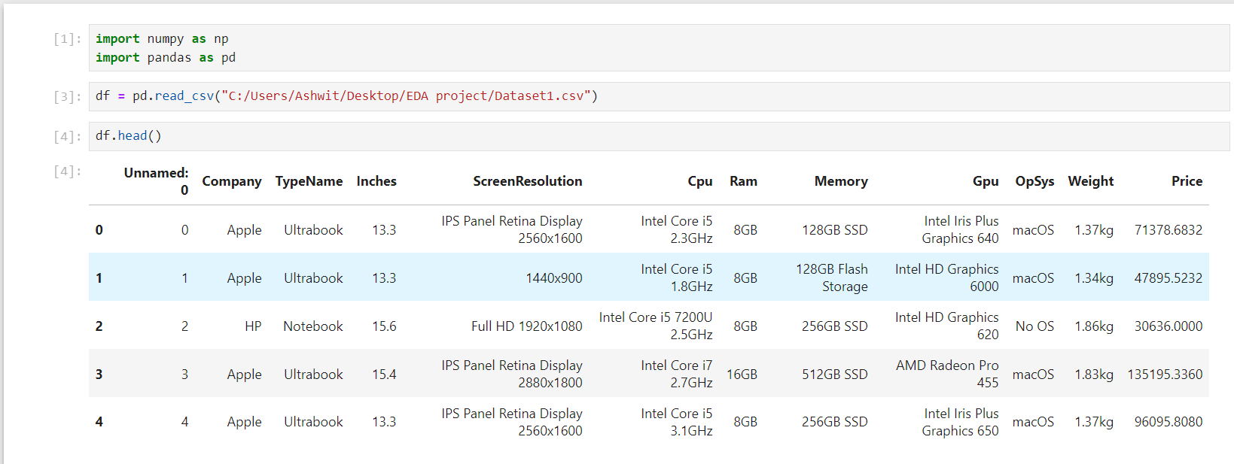
Explanation
Useless column unnamed

Slide 24
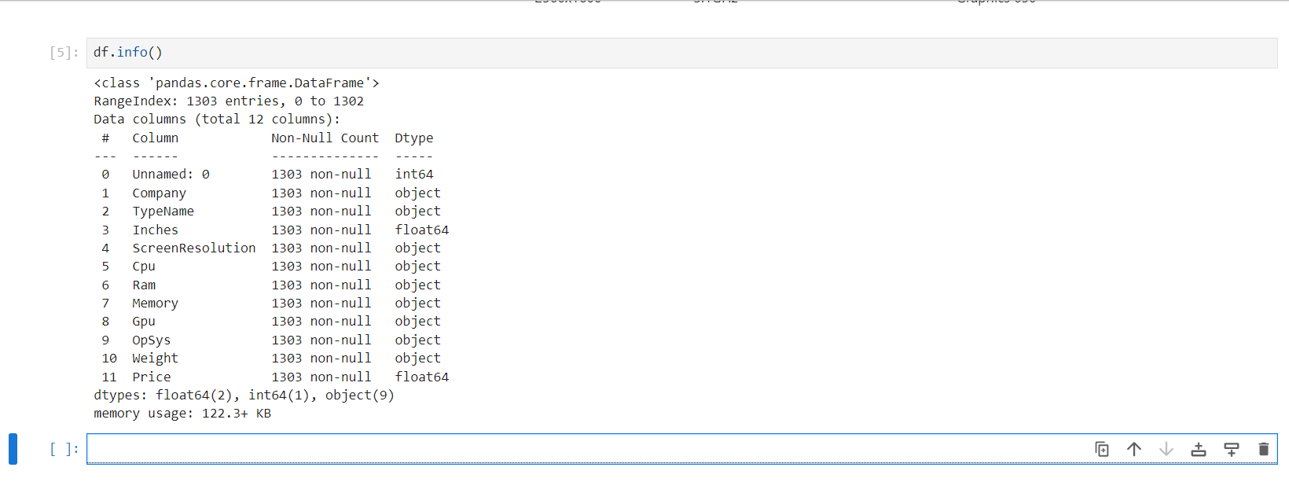
RAM and weight should have been numeric not object
Price need not be float

Slide 25
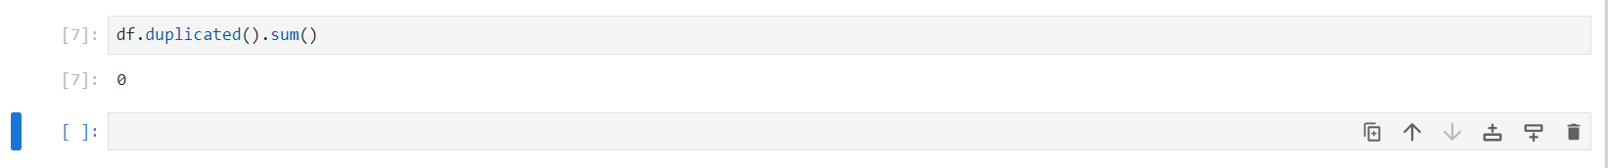
No duplicated rows

Slide 26
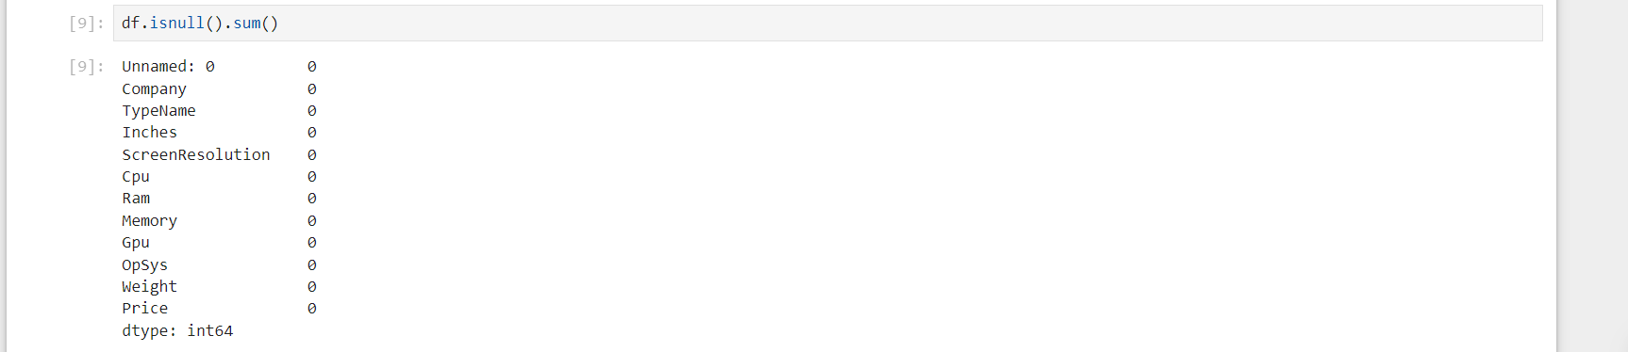
No null values

Slide 27
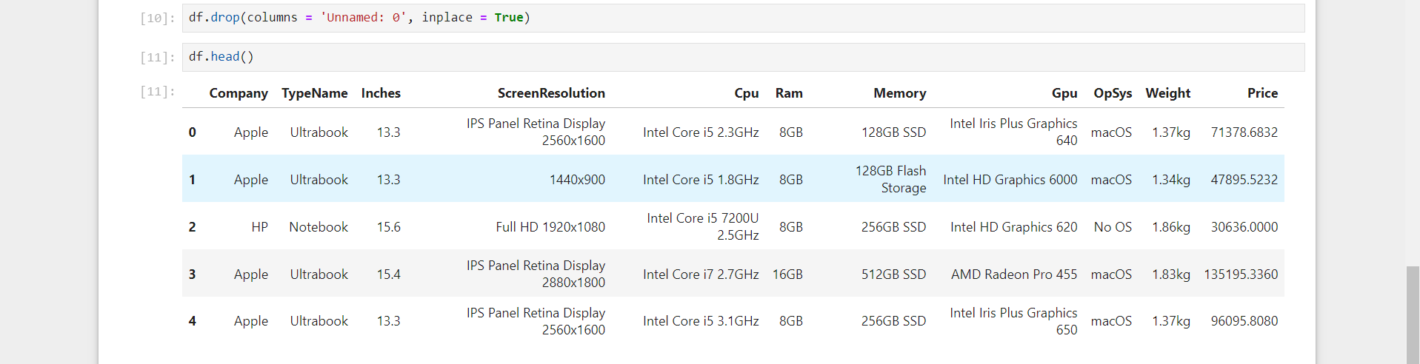
Unnamed column dropped

Slide 28
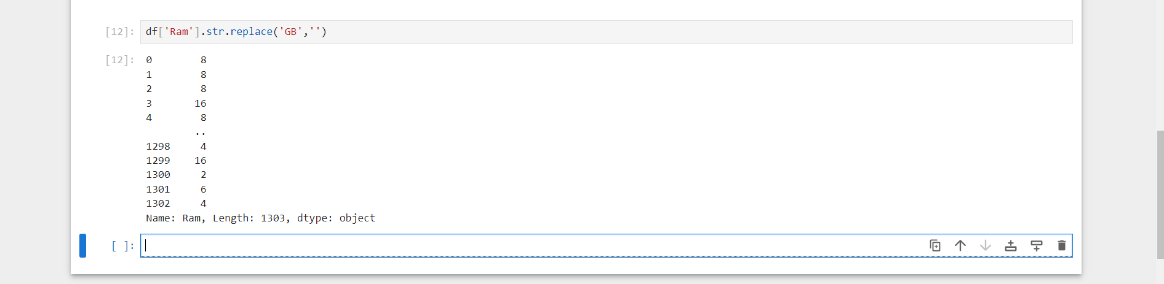
GB removed

Slide 29
Removing Kg

Slide 30
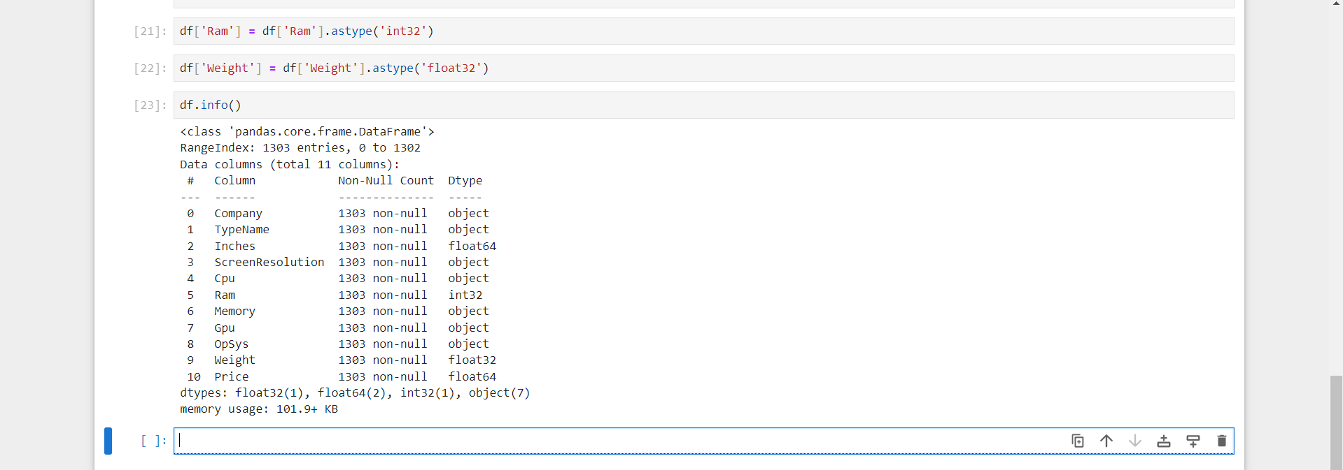
Changing data types

Slide 31
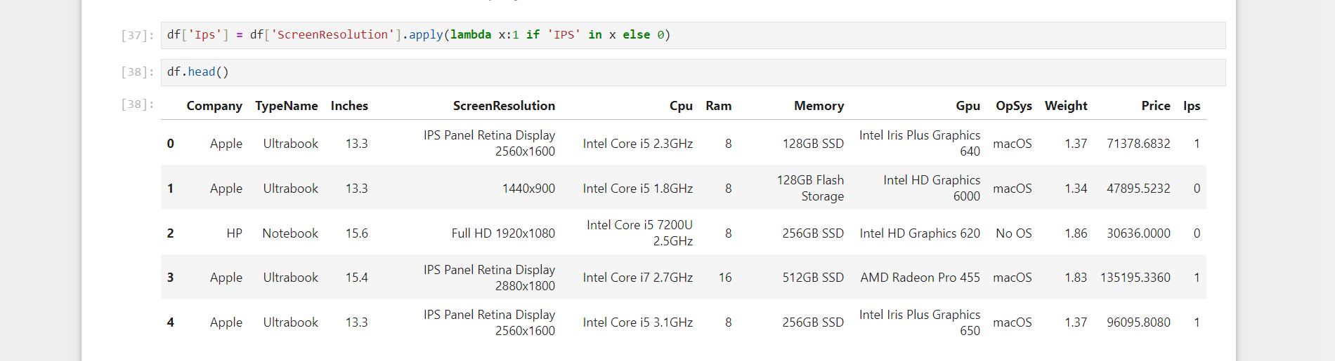
Inserting IPS column for laptops which have IPS

Slide 32
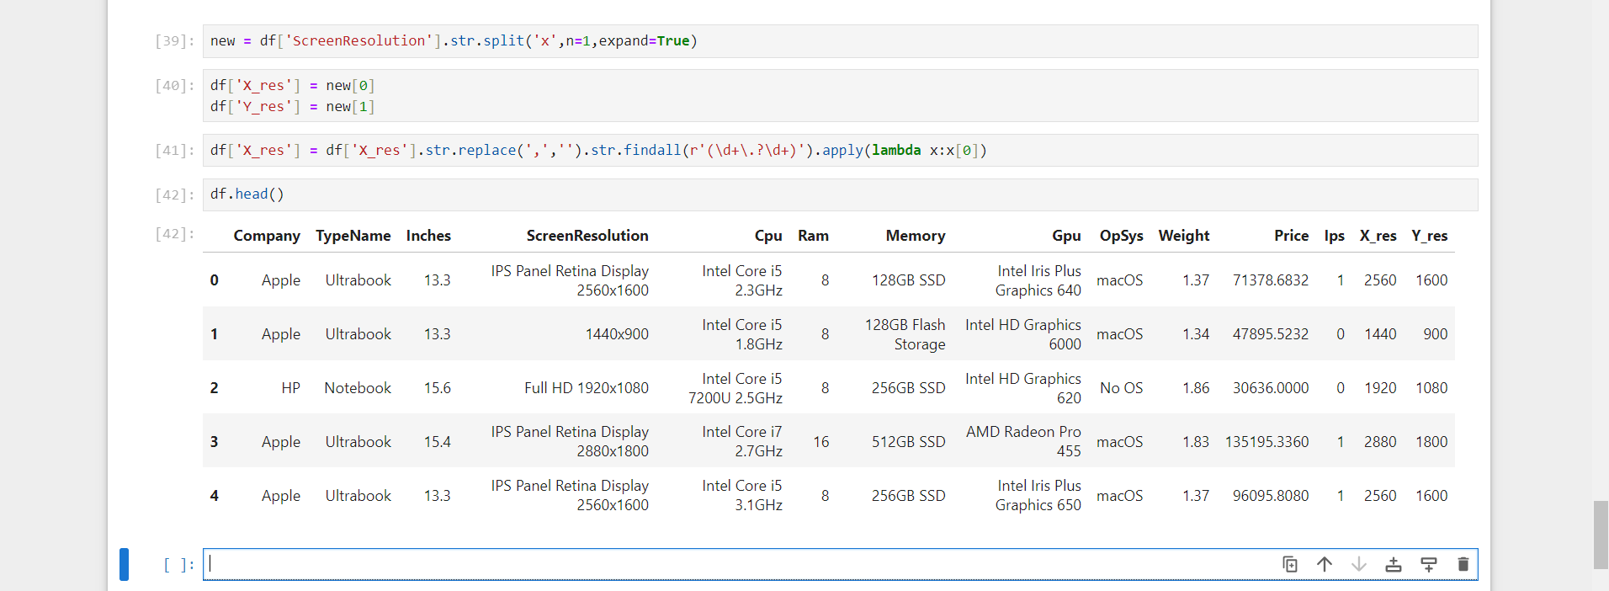
Inserting X and Y resolution (Separation)

Slide 33
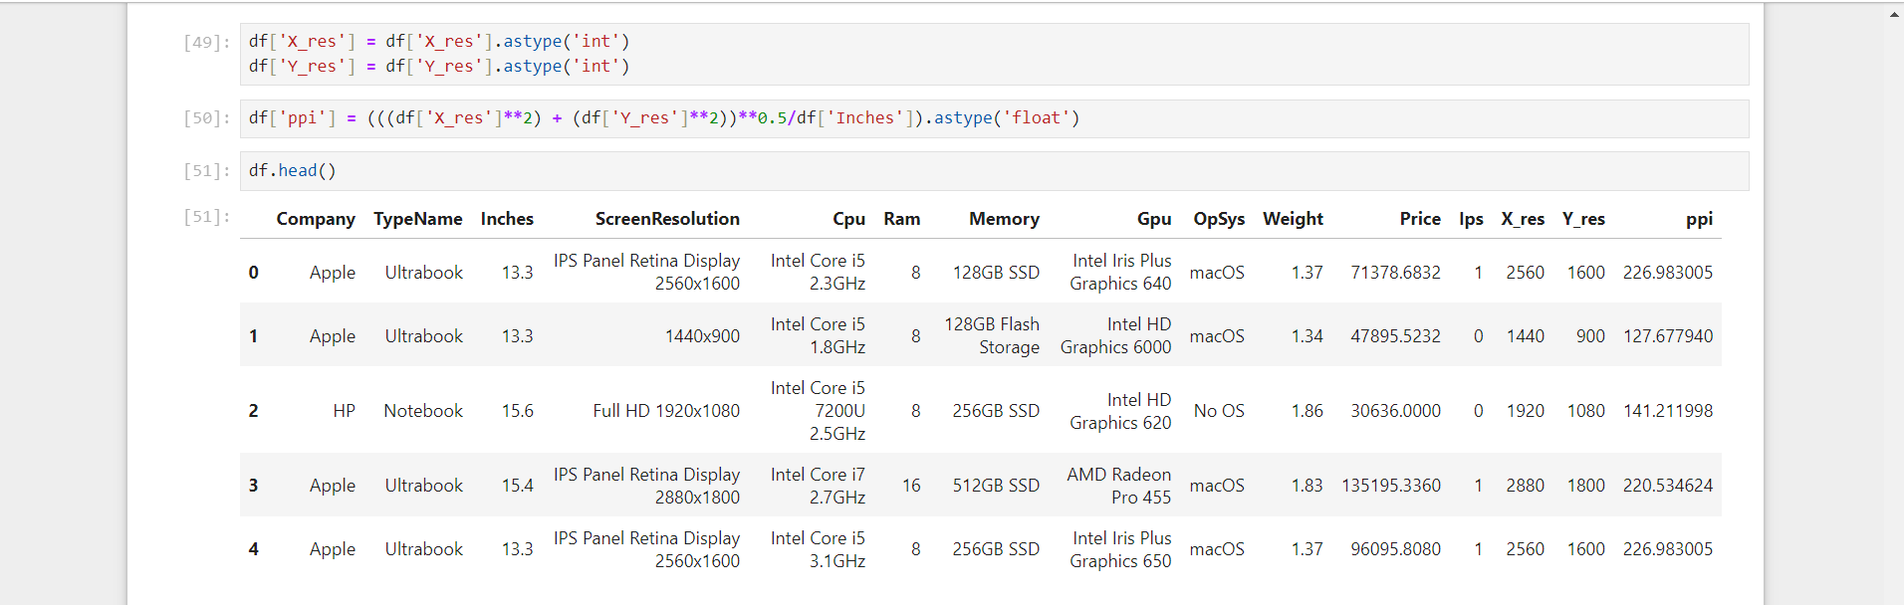
PPI

Slide 34
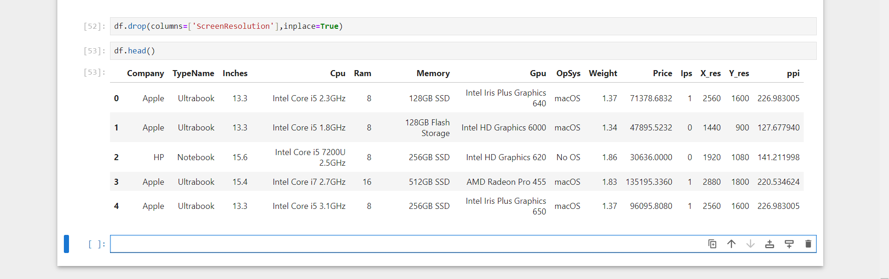
Removing screen resolution since it is not needed

Slide 35
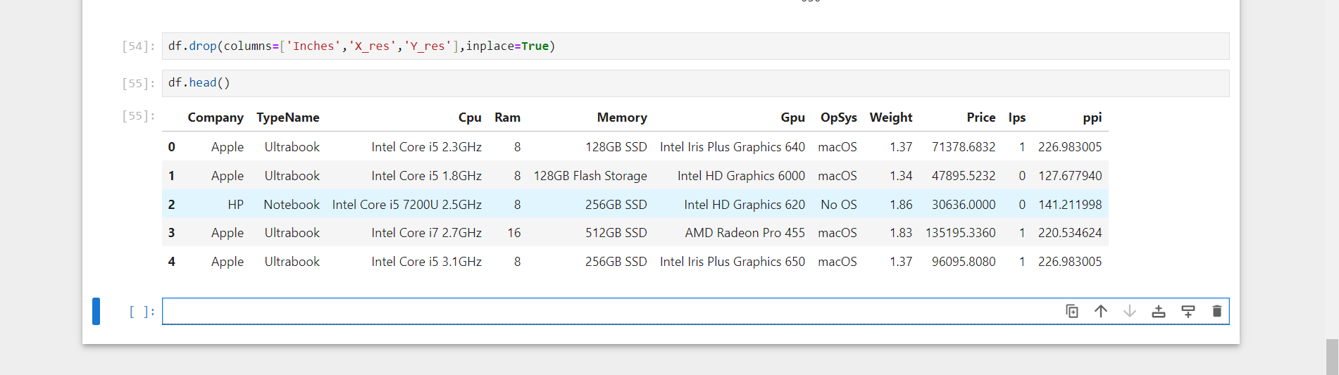
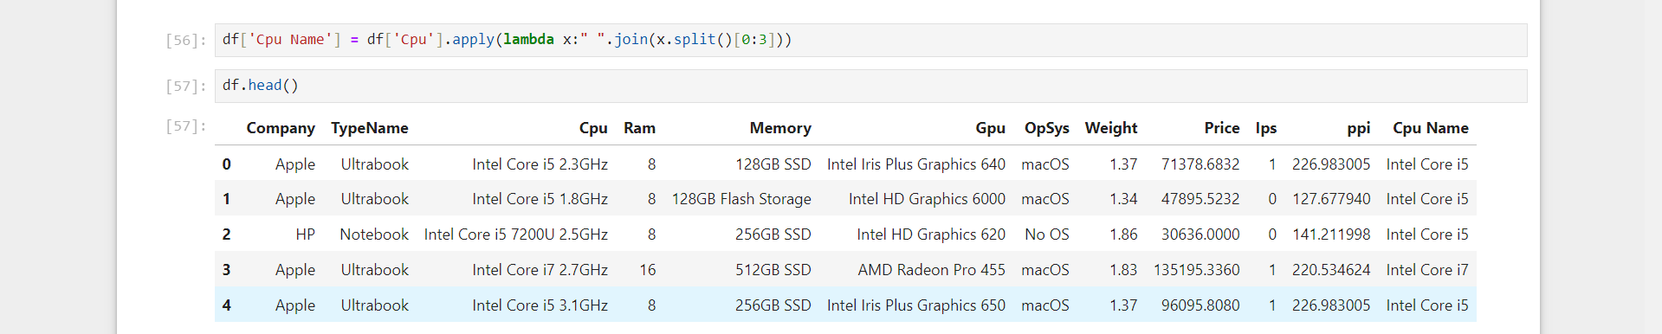
Getting CPU name

Slide 36
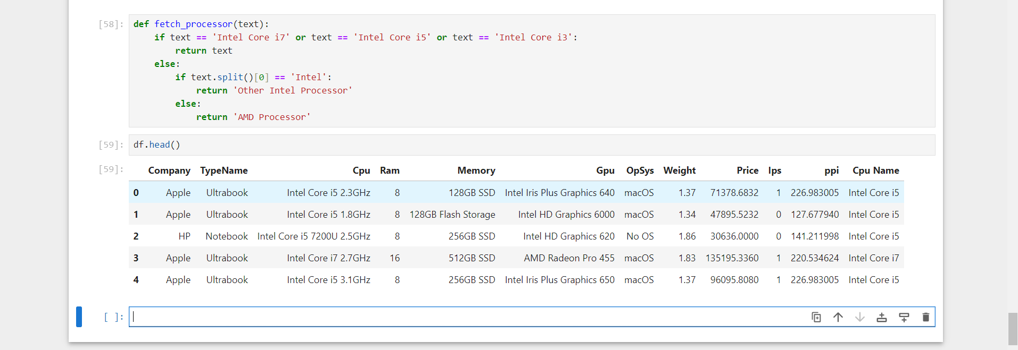
AMD or Intel

Slide 37
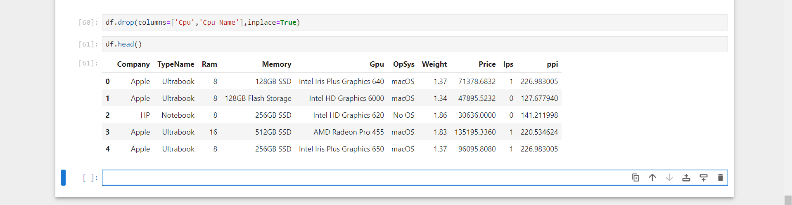
Dropping CPU and CPU name

Slide 38
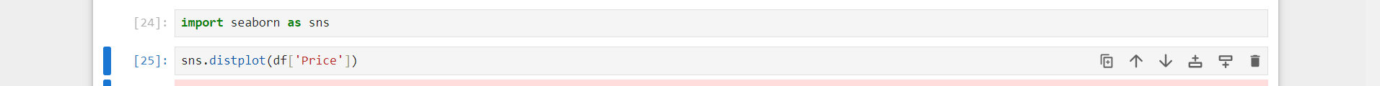
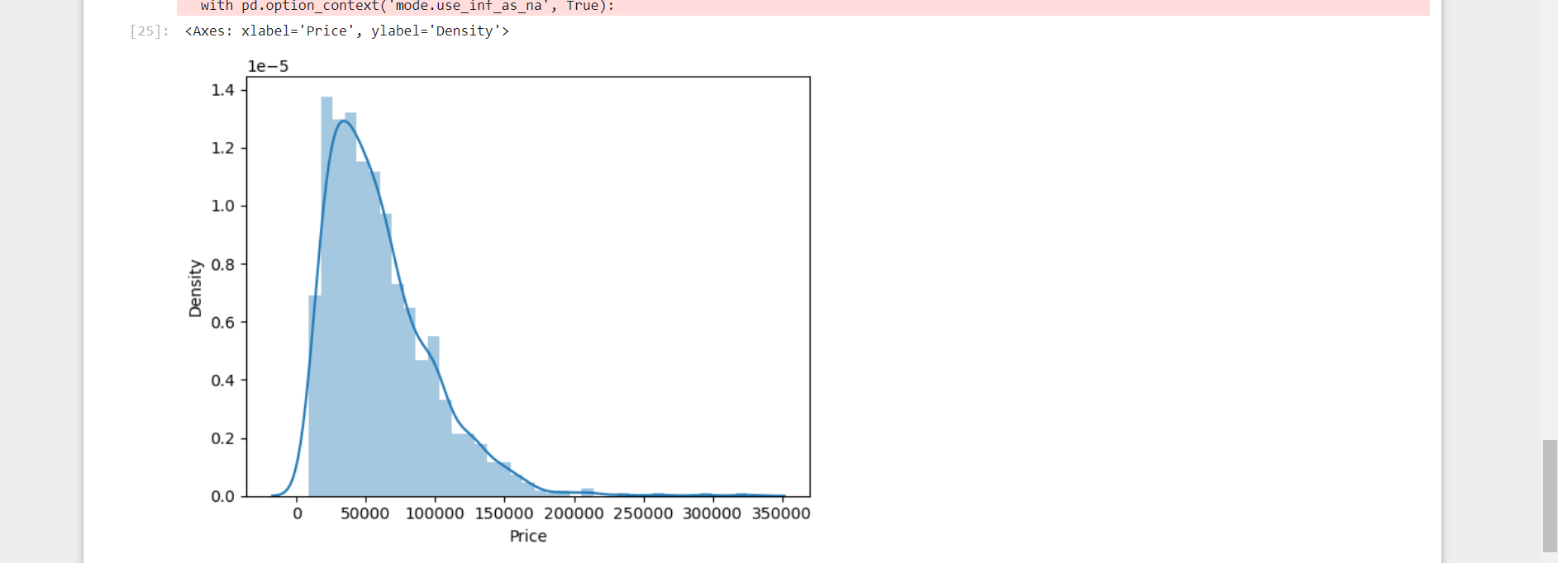
Post processing(python + power bi) visual representation

Slide 39
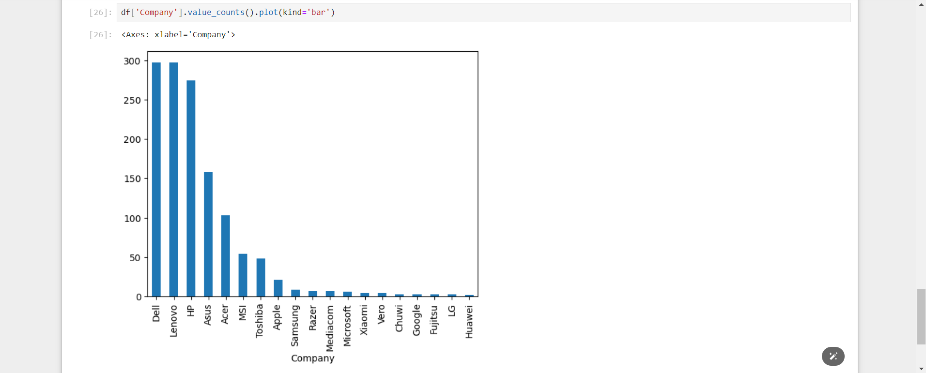

Slide 40
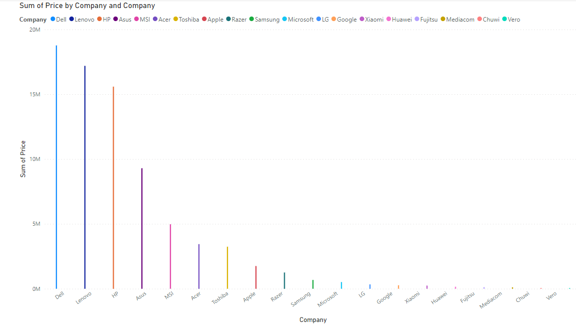
Company vs price

Slide 41
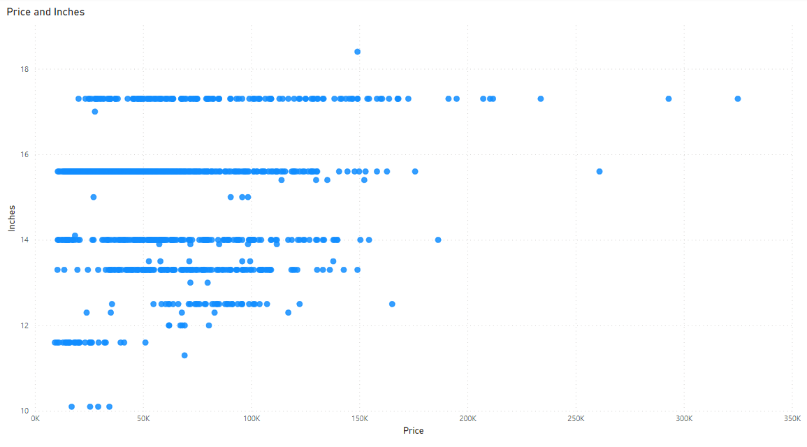
Price vs inches

Slide 42
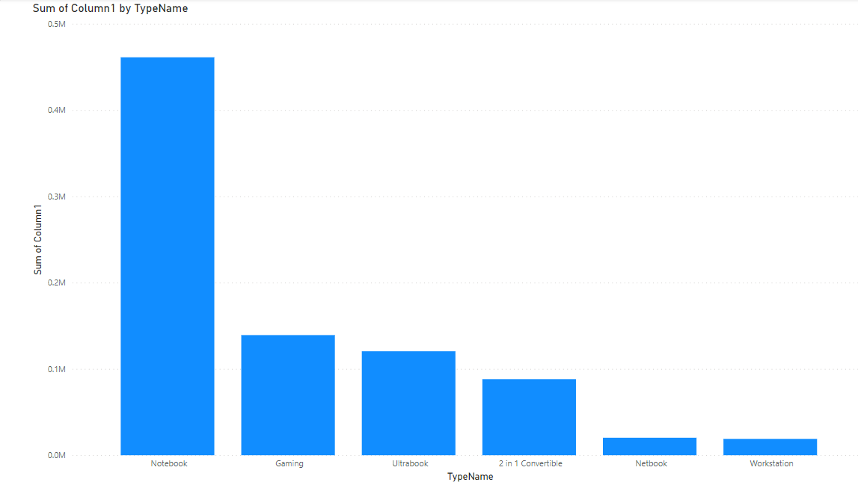
Types of laptop

Slide 43
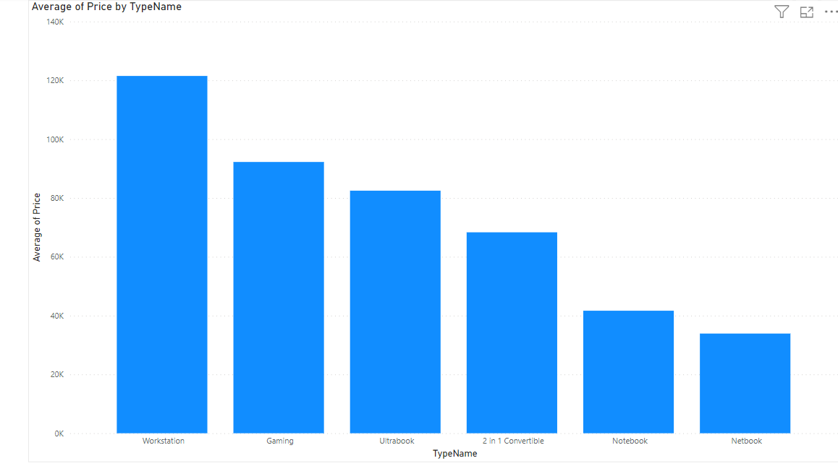
Types of laptop vs their price

